Slide 1


SMART INDIA HACKATHON 2024
TITLE PAGE
Problem Statement ID :- 1614
Problem Statement Title :- Publications summary generator for faculty members profile building
Theme :- Smart Education
PS Category :- Software
Team ID :- #######
Team Name :- ByteForce

Slide 2
IDEA TITLE
ByteForce
Proposed Solution:- ARPER(Academic Research and Publication Evaluation Repository)
Solution Overview
How It Solves the Problem
Comprehensive Solution: A streamlined platform to simplify faculty profile management and academic publication summarization
Core Features:
Crawling & Data Retrieval: Automates data extraction from top academic databases
Custom Queries: Tailor’s publication records for specific timeframes
Export Functions: Effortlessly exports data in Word and Excel formats
Faculty Profiles: Showcases comprehensive publication histories
Precision Search Filters: Delivers ultra-targeted, dynamic filters for pinpoint publication retrieval
Data Security: Guarantees secure handling and storage of sensitive information
Streamlines Accreditation: Delivers structured data for swift compliance submissions
Minimizes Manual Labor: Automates data retrieval, optimizing efficiency and time
Amplifies Research Impact: Elevates faculty visibility and institutional recognition
Enables Strategic Insights: Provides actionable data for informed research decisions
Unique Features of Our Solution
AI-driven Assistance: Allows instant, direct interaction with publications via a smart chatbot
Autonomous Data Harvesting: Streamlines acquisition from top academic repositories
Precision Customization: Delivers finely tuned, bespoke publication filters
Omnichannel Export: Facilitates seamless, multi-format dissemination

Slide 3


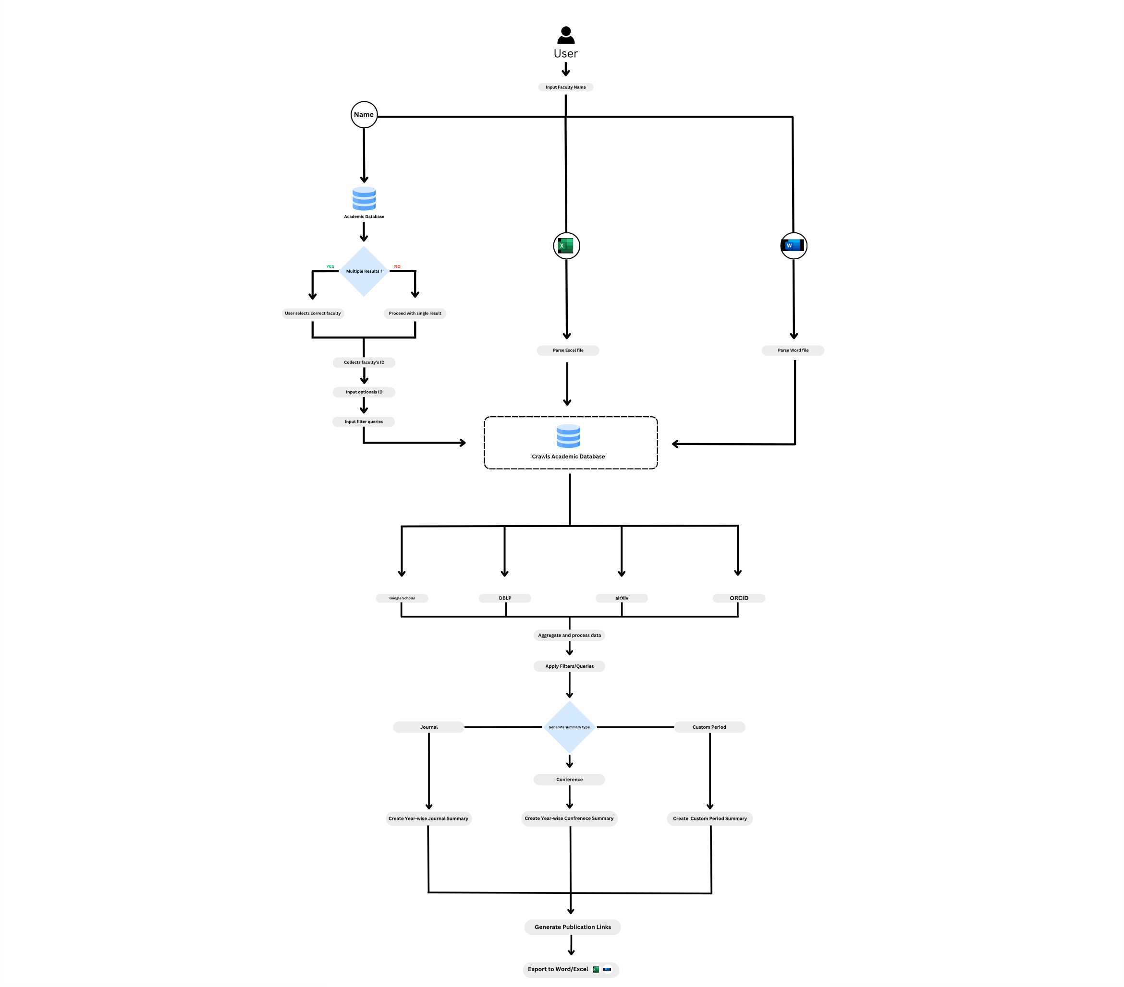









TECHNICAL APPROACH
ByteForce
Tech Stack
Process Flow
Frontend:
React.js & Tailwind CSS: Engaging & responsive web interface.
Backend:
Django: Handles backend services.
Libraries:
Data Processing & File Generation: python-docx, Pandas, Bibtex parser , Numpy
Visualization: Matplotlib, chart.js
Crawling & Data Retrieval:
APIs and SDKs: Integration with scholarly databases such as Google Scholar, DBLP, CrossRef, ORCID, and arXiv.
Database:
PostgreSQL: Structured storage of faculty profiles and publication records.
Cloud Services:
Firebase: OAuth-based email authentication
AWS: EC2 for web hosting & RDS for database management

Slide 4
FEASIBILITY AND VIABILITY
ByteForce
Feasibility Assessment
Key Challenges and Responses
Technical Feasibility:
State-of-the-Art Stack: Employs cutting-edge technologies for robust performance and scalability
Data Integrity: Ensures rigorous security protocols and compliance for sensitive information
Financial Feasibility:
Cost-Effective: Leverages efficient, cost-conscious solutions to minimize initial investment
Market Feasibility:
High Demand: Addresses a pressing need for streamlined publication management
Competitive Advantage: Distinguishes with advanced features and a user-centric approach
Operational Feasibility:
Efficient Implementation: Streamlined deployment process ensures timely project execution
Challenge: Integrating Diverse Data Sources Mitigation: Leverage a suite of APIs and libraries for robust data integration and processing
Challenge: Data Accuracy Concerns Mitigation: Enforce stringent validation protocols and multi-source checks to guarantee data precision
Challenge: Export Functionality Management Mitigation: Deliver flexible export solutions for Word and Excel, optimizing user experience
Challenge: User Adoption Barriers Mitigation: Provide in-depth training and user-friendly interfaces for effortless adoption
Challenge: Complex Data Mapping Mitigation: Design intuitive data mapping tools to simplify the alignment of diverse data sets

Slide 5
IMPACT AND BENEFITS
ByteForce
Impact on Target Audience
Key Benefits
Positive Impact:
Enhanced Academic Renown: Amplifies faculty prominence and profile distinction
Streamlined Data Aggregation: Refines the consolidation and management of research outputs
Bespoke Accreditation Reports: Delivers customized summaries for precise institutional needs
Effortless Data Transition: Facilitates smooth transfer across multiple formats
Insightful Strategic Analytics: Provides actionable intelligence to guide academic strategies
Negative Impact:
Scalability Constraints: Initial scaling may be limited, but modular upgrades will support growth.
Data Integration Hurdles: Combining data sources can be complex, yet advanced methods will ensure smooth management.
For Institution:
Accreditation-Optimized: Delivers detailed, compliance-focused summaries
Efficiency Boost: Accelerates data processing and report generation
Unified Records: Integrates diverse publications seamlessly
Strategic Insights: Provides actionable data to refine institutional objectives
For Faculty:
Elevated Prestige: Enhances academic profiles with precise summaries
Bespoke Reports: Custom outputs for institutional standards
Rapid Export: Effortless transfer across formats
Streamlined Oversight: Simplifies academic record management

Slide 6
RESEARCH AND REFERENCES
ByteForce
Research and Academic Papers:
BibTeX Citation Guide
A Survey of Content Management Systems for Scholarly Information
Articles:
How to Conduct a Literature Search for Systematic Reviews
Content Management System
Case Studies and Implementation Examples:
Exploring Research Profiling Platforms: A Case Study
VIDWAN: National Researcher Network

